Slide 1


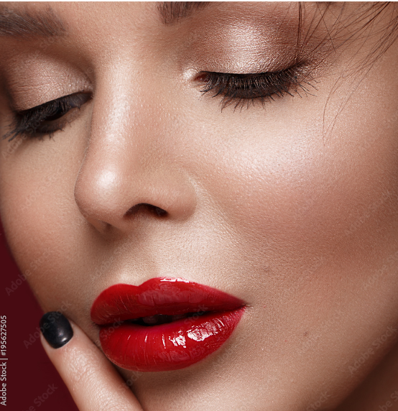
BASIC MAKEUP
Enhance Your Beauty in Simple Steps

Slide 2
CONCLUSION
Check your makeup
Set up
Final look
Ready to go
By following these steps , you can achieve a flawless make up finish every time .

Slide 3





Slide 4


